Slide 1
SP&L Homework #2, AA2024-2025:
Adaptive Interference Mitigation on Audio Signal
Team member1: Minglei Shao 11029173@polimi.it
Team member2: Hong Chen 11029173@polimi.it
Team member3: Ming Yang 11029173@polimi.it

Slide 2

Catalogue
1. Basic Model
2. Basic Principles
3. Project Results Display

Slide 3
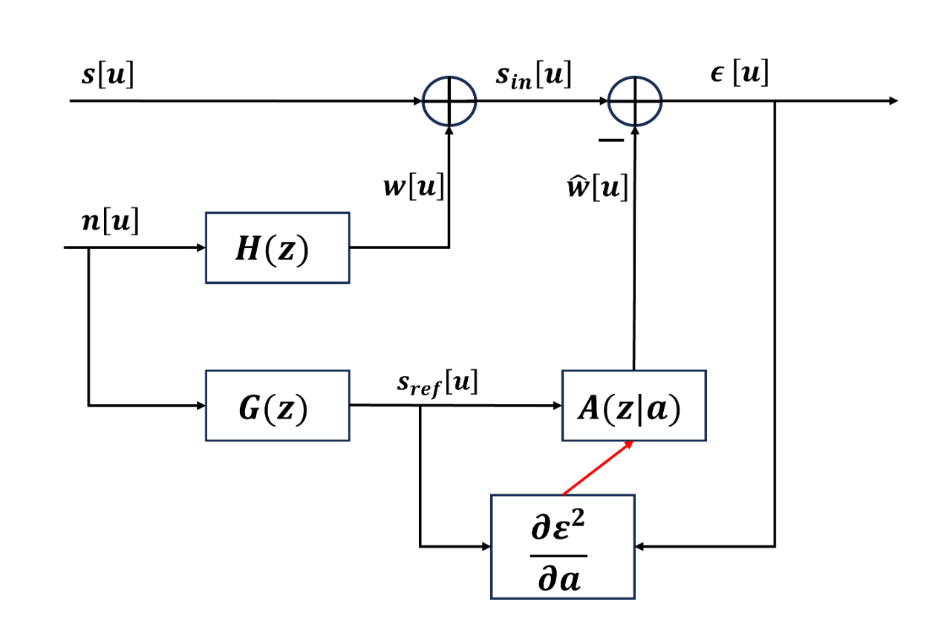
Basic Model
The input contains two signals, one that is polluted by noise and one that is a reference signal to noise. What we want to do is to use an adaptive filter to approximate the reference signal as close as possible to the noise in the original signal to achieve the effect of noise reduction

Slide 4
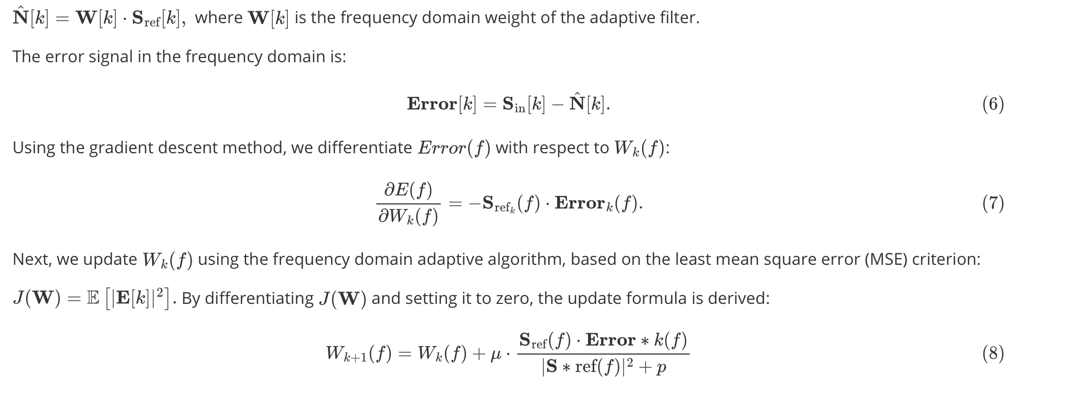
Basic Principles
Frequency domain adaptive filter
After comparison here, we choose to use the adaptive filter in the frequency domain, first convert the signal to the frequency domain, then calculate the error signal, and then constantly update the weight of the filter based on the LMS, and finally convert back to the time domain.

Slide 5
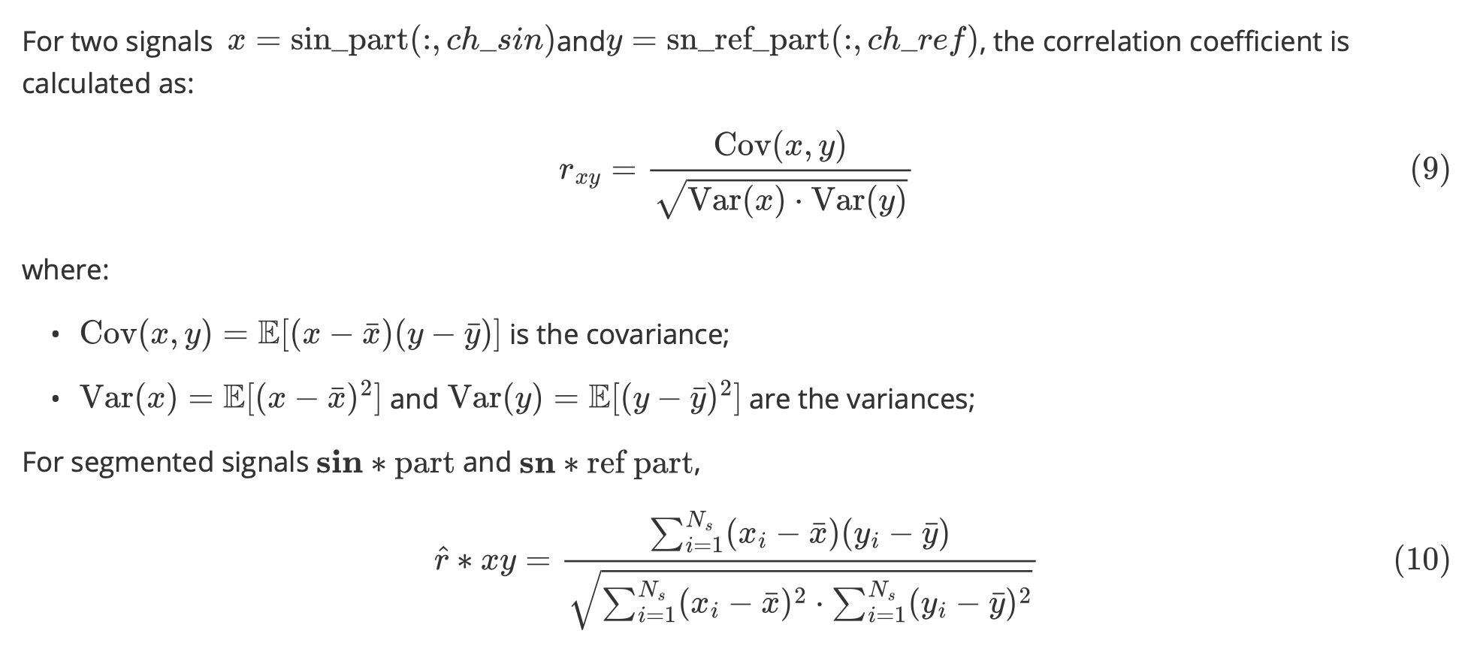
Basic Principles
Pearson correlation coefficient
Since the signal and the reference noise signal do not always correspond, here we segment the signal and the reference signal and calculate the correlation coefficient to determine the best mapping relationship between the signal and the reference noise.

Slide 6
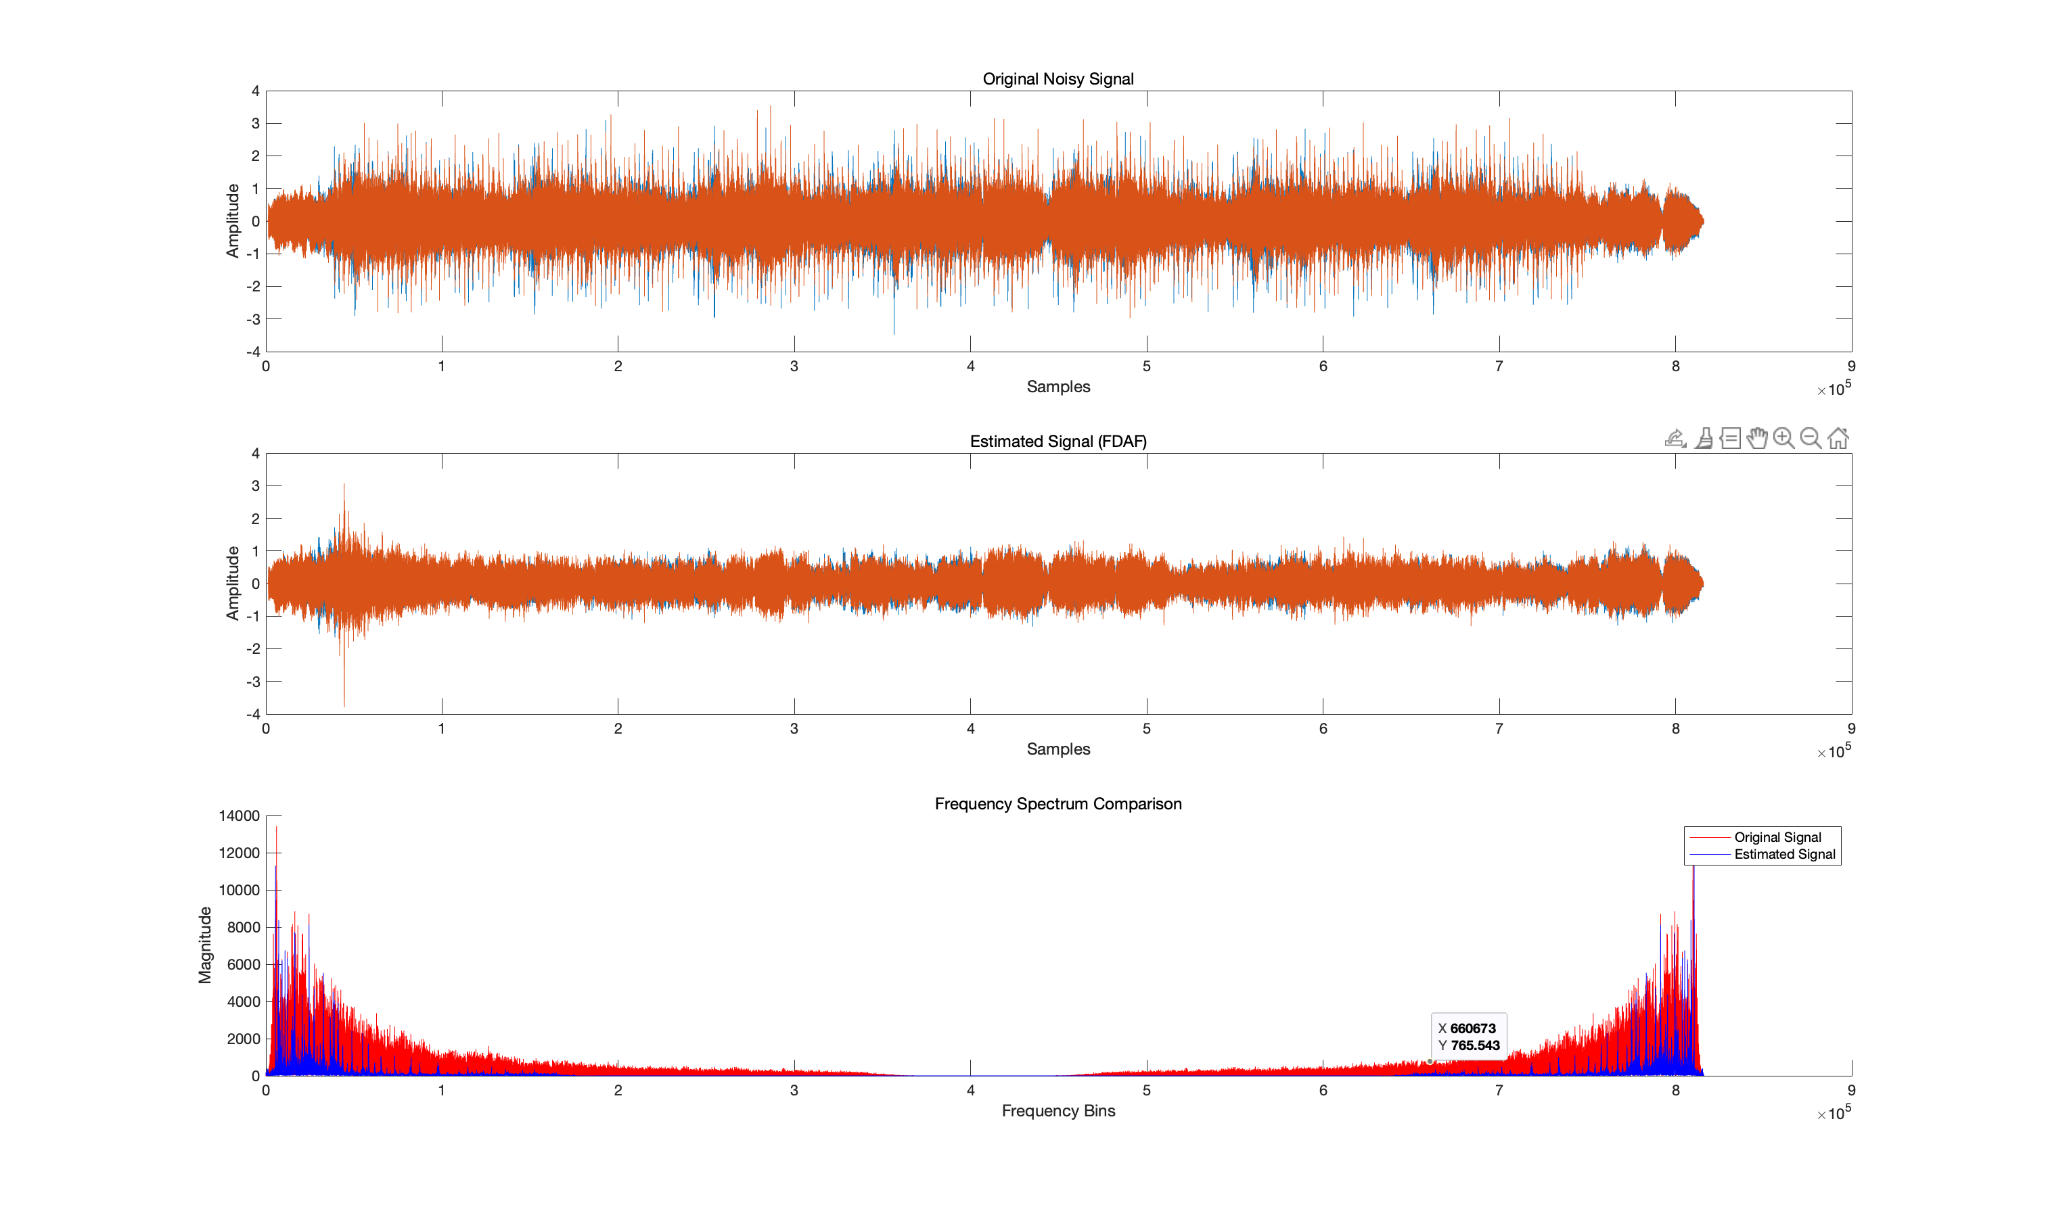
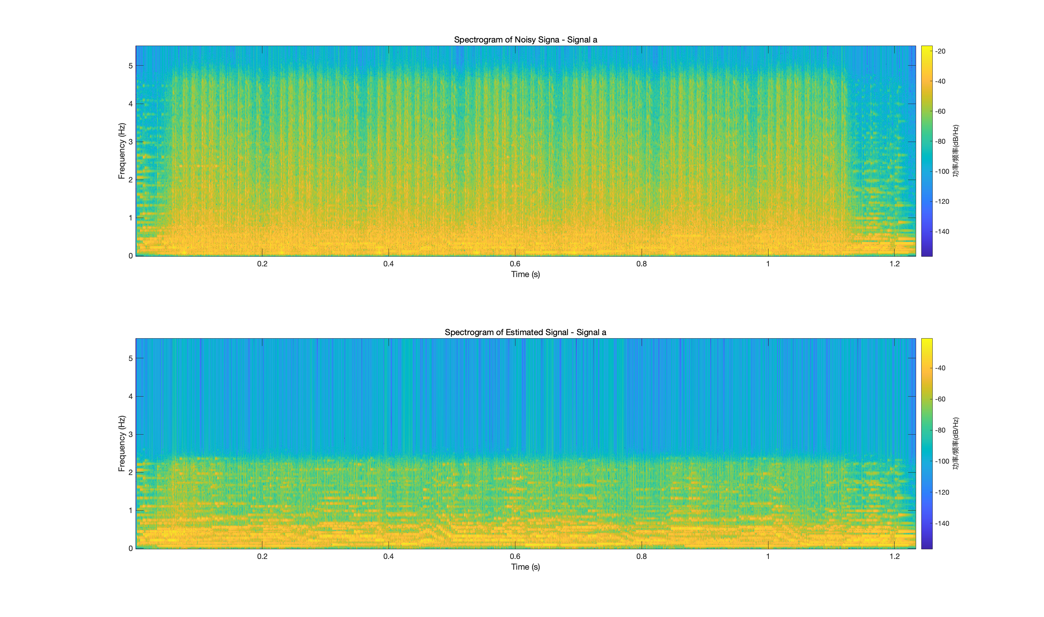
Results Display
Result for Exercise A
For the amplitude diagram in the time domain, it is obviously smoother, and the shape of the original signal is retained while removing the noise
For the results in the frequency domain, the noise is significantly reduced, the red part is the contaminated original signal, and the blue is the processed signal
Spectral results, In the higher frequency regions, the colors are evidently darker, indicating reduced noise intensity. The frequency bands in the denoised spectrogram are more concentrated.

Slide 7
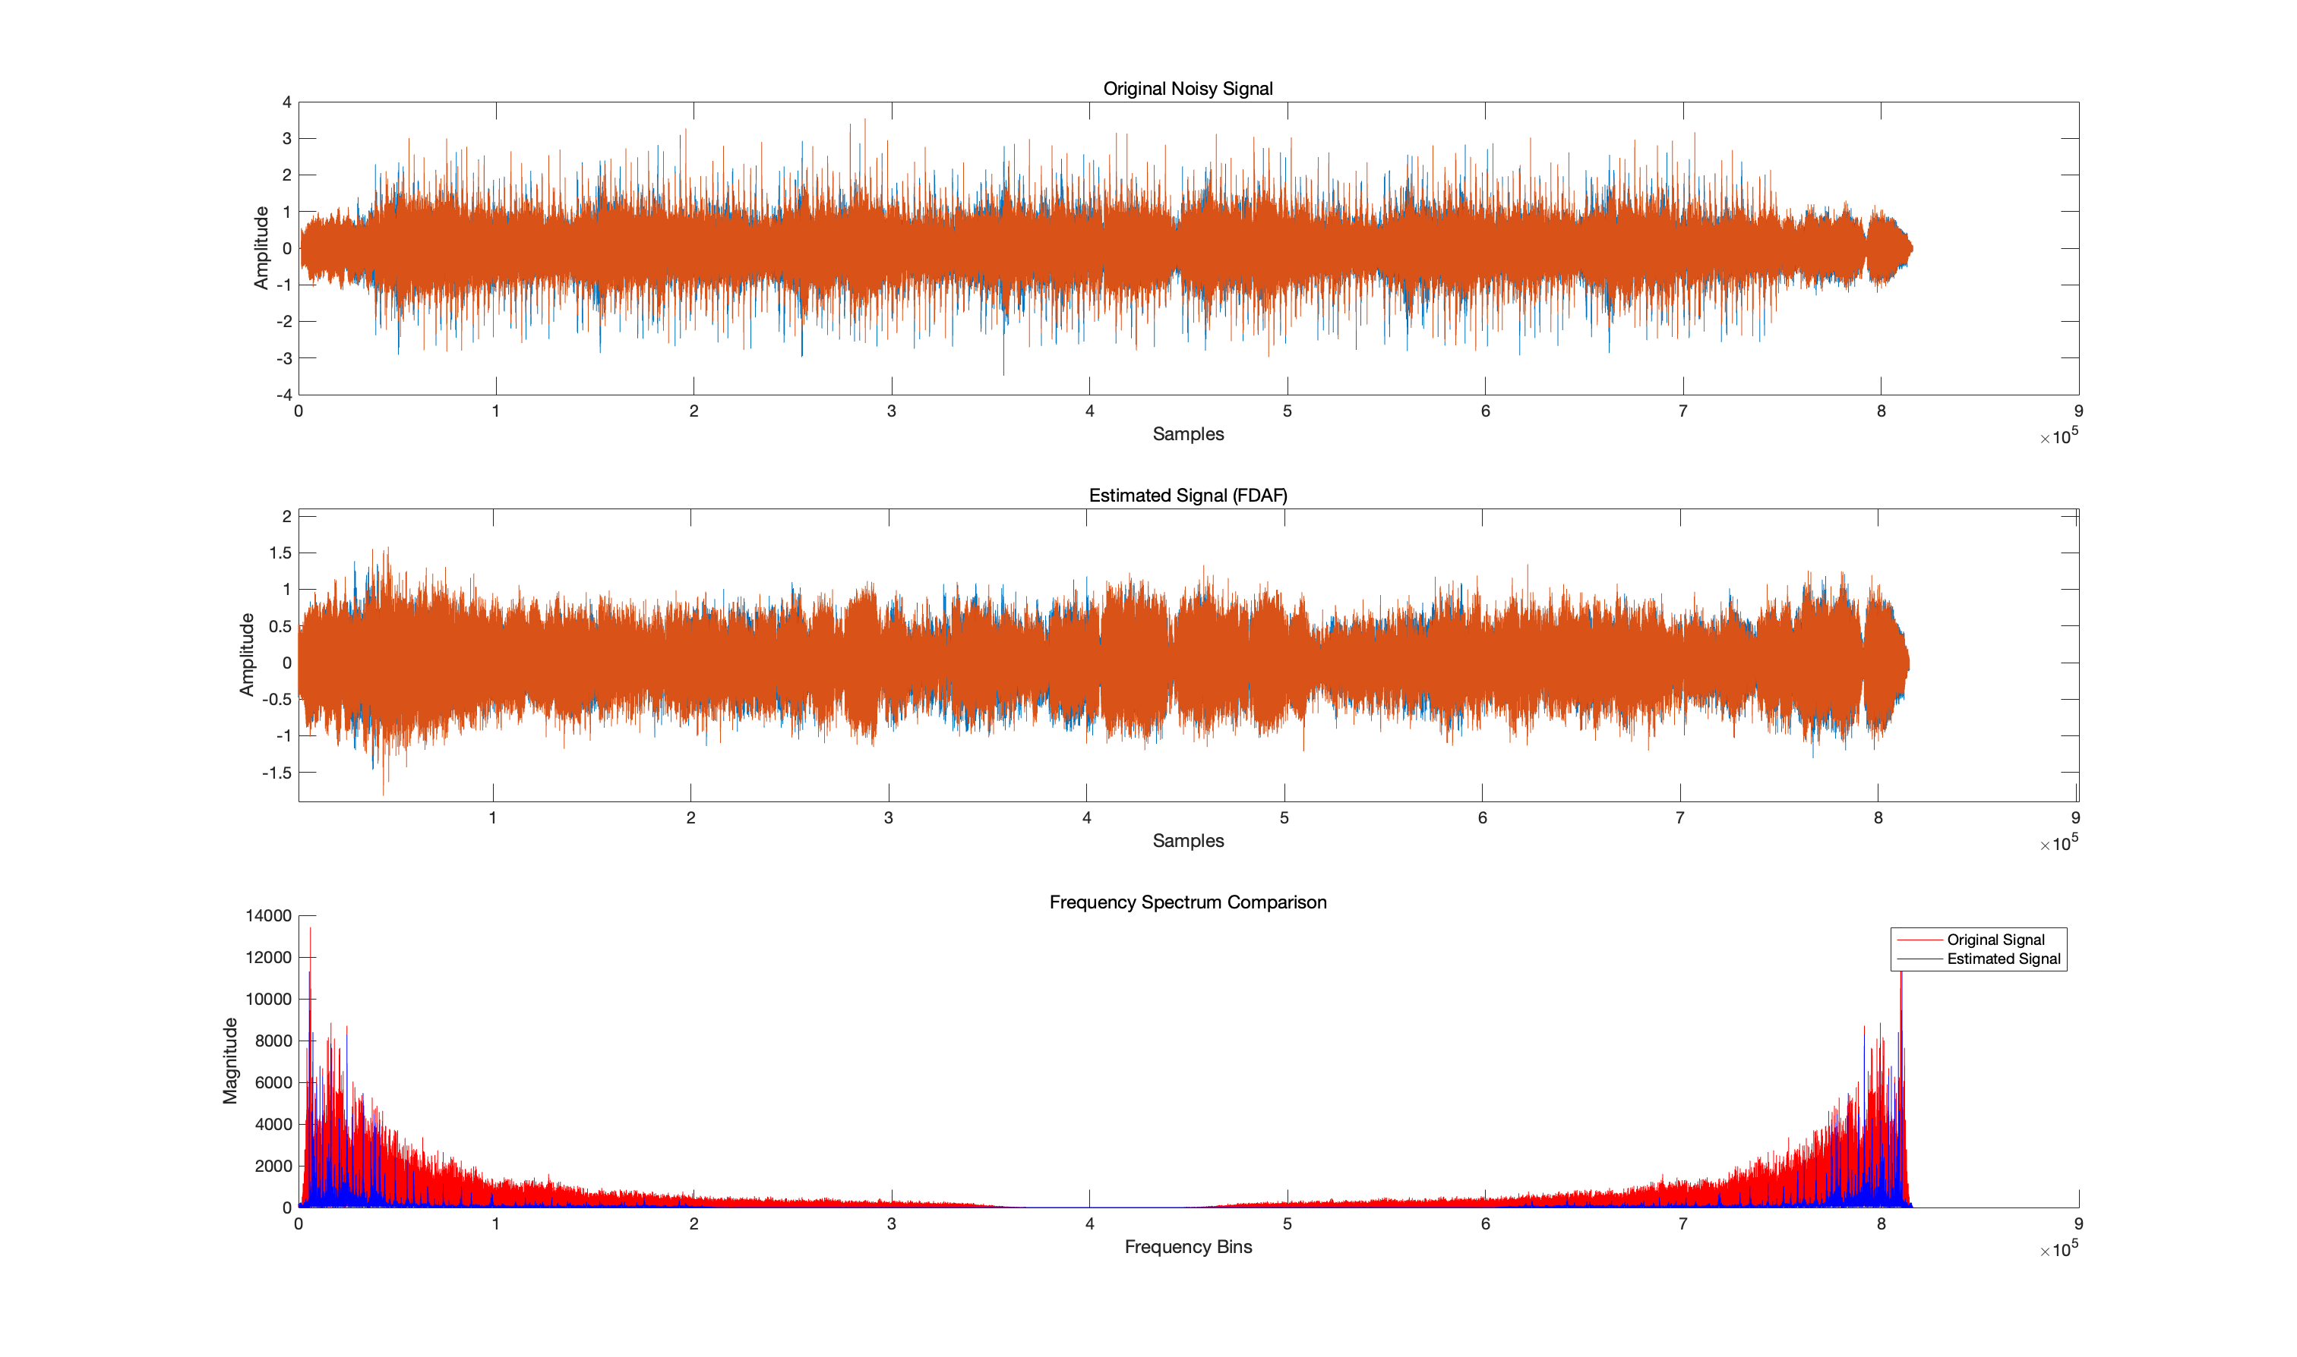
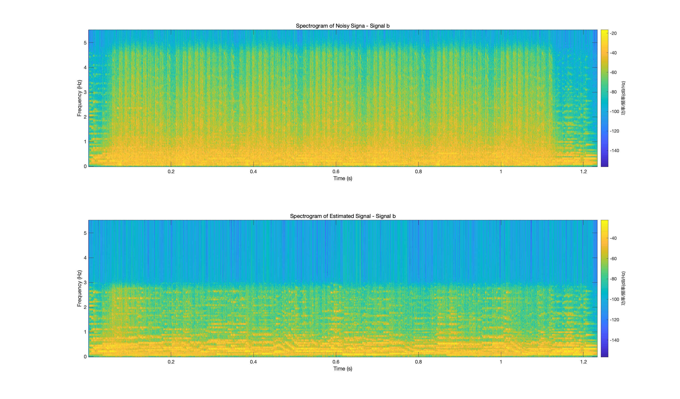
Results Display
Result for Exercise B

Slide 8
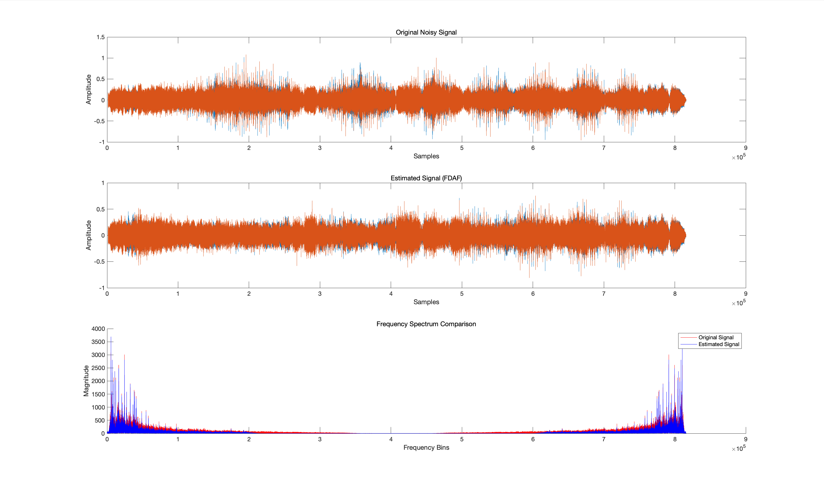
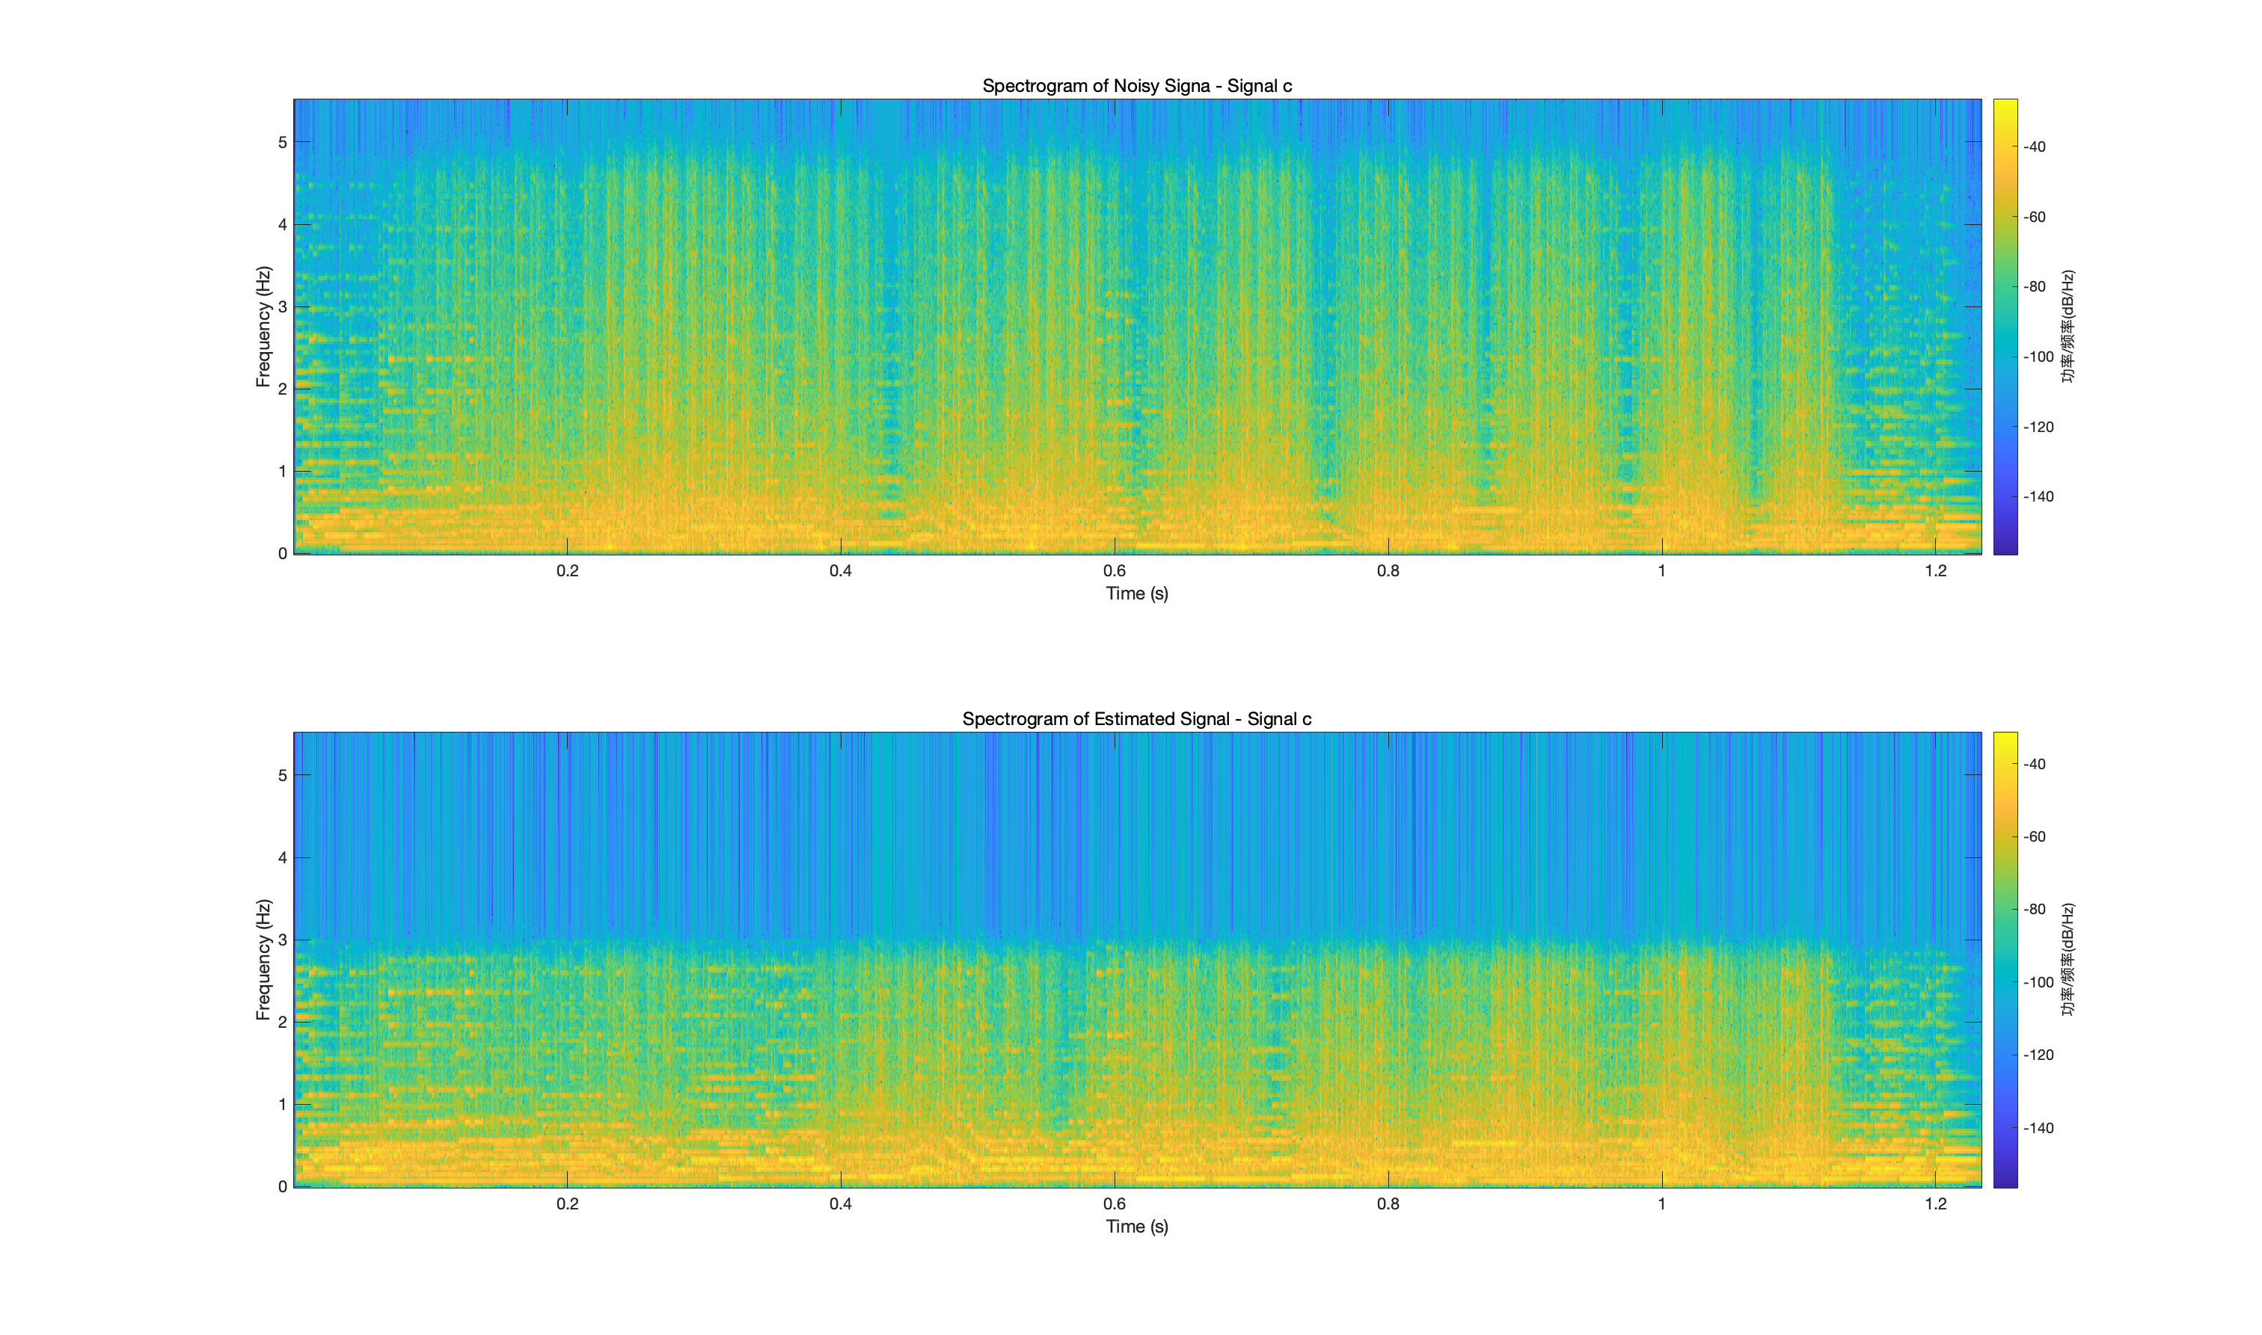
Results Display
Result for Exercise C

Slide 9

Results Display
Result for Exercise A
Result for Exercise B
Result for Exercise C

Slide 10

Thanks！！

